Slide 1
EVENTS MANIA
GROUP MEMBERS:
SYED SOHAIB ALI
FIZZA SAEED
SHAZMA RAHIM

Slide 2
INTRODUCTION
MARRIAGE IS A PERMANENT BOND THAT KNOT TWO FAMILIES TOGETHER.THE MARRIAGE HALL BUSINESS HAS BEEN A GLOOMING BUSINESS IN RECENT YEARS . IT HAS PROVEN PROFITABLE IN MAJOR CITIES DUE TO THE POPULATION INCREASE AND CHANGING LIFESTYLE PATTERNS. THESE DAYS, MOST OF THE TRADITIONAL MARRIAGE HALLS ARE BEING CONVERTED INTO BANQUETS OR MARQUEE DUE TO TRENDS AND CLIENT PREFERENCES. A BANQUET HALL, FUNCTION HALL, OR RECEPTION HALL, IS A SPECIAL-PURPOSE ROOM OR A BUILDING USED FOR HOSTING LARGE SOCIAL AND BUSINESS EVENTS AND MARRIAGES. SIMILARLY, A BALLROOM IS A LARGE ROOM INSIDE A BUILDING, THE PRIMARY PURPOSE OF WHICH IS TO HOLD LARGE FORMAL PARTIES.

Slide 3
EXPLANATION
Events mania is an event-planning website, in which our aim is to bring all factors together to produce a workable event. We capture different events like (MEHNDI- MAYYUN, BARAAT, VALIMA, CONFERENCES ETC) and provide the customers different themes so they can choose their dream theme and make their event memorable.

Slide 4
FUNCTIONAL FEATURES
DROP-DOWN NAVIGATION
NAVIGATION BAR HOVER
IMAGE BOX HOVER

Slide 5
IDE
VISUAL STUDIO CODE
HTML
CSS

Slide 6
PROJECT REQUIREMENTS
Minimum 10 pages
Home
About
Gallery
Events > MAYYON > WEDDING > RECEPTION > BIRTHDAY > CONFERENCE
Location
Contact Us

Slide 7
NON-FUNCTIONAL FEATURES
PERFORMANCE
USER EXPECTATION
SECURITY

Slide 8
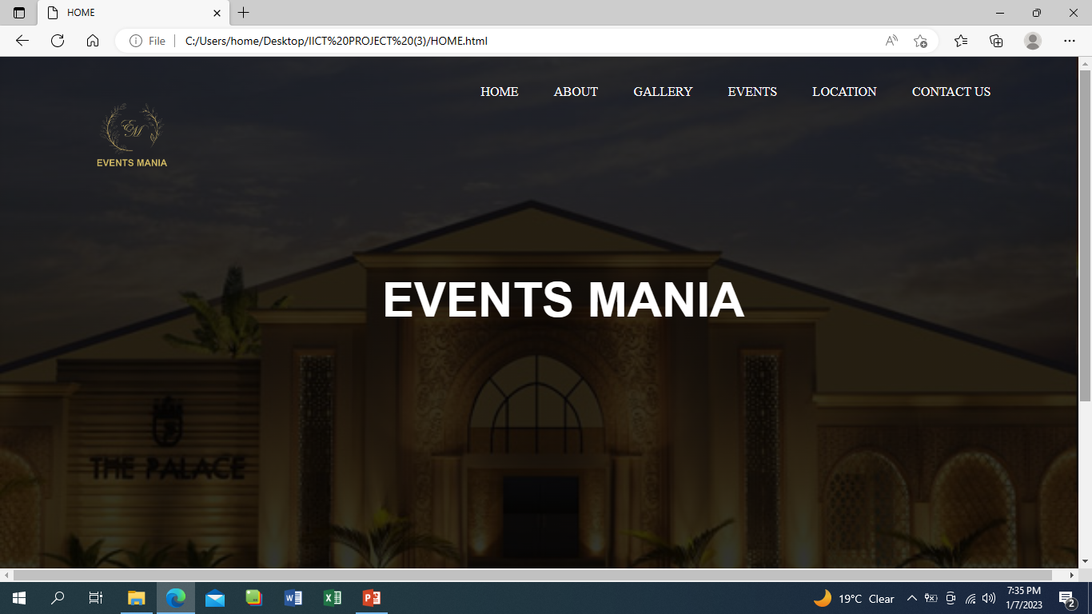
SCREEN SHOT

Slide 9
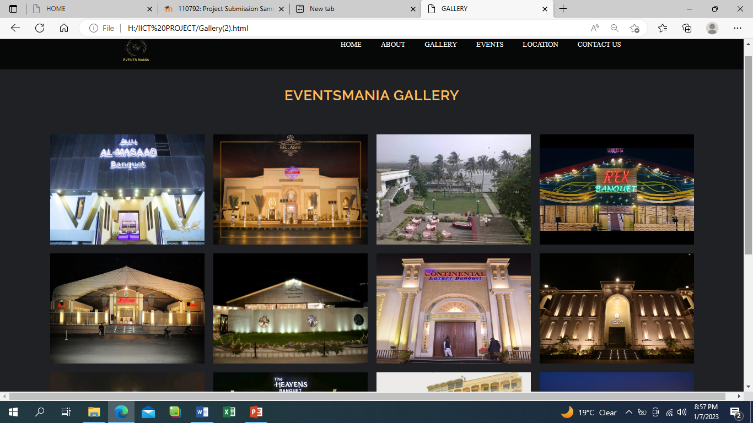

Slide 10
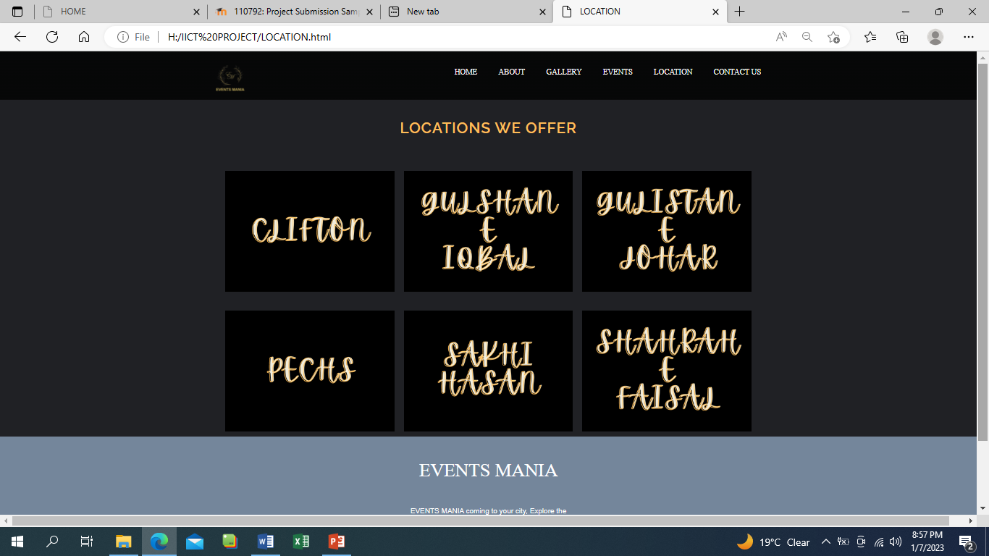

Slide 11
CONCLUSION
THE EVENT PLANNING SKILL IS AN ESSENTIAL THING BEFORE ARRANGING THE EVENT THAT IS YOU CAN JOIN WITH EVENTSMANIA.HTML FOR ENHANCING YOUR SKILLS IN EVENT AND IT WILL LEAD THE SUCCESSFUL AND MEMORABLE EVENT.

Slide 12
THANK YOU!!

